Slide 1
10 McDonald’s ads

Slide 2
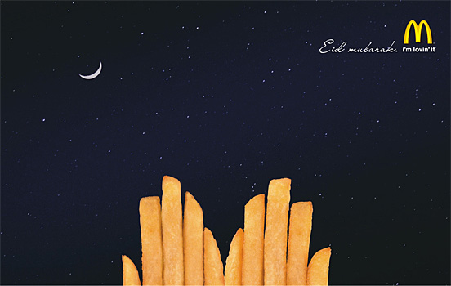
1. Eid mubarak

Slide 3
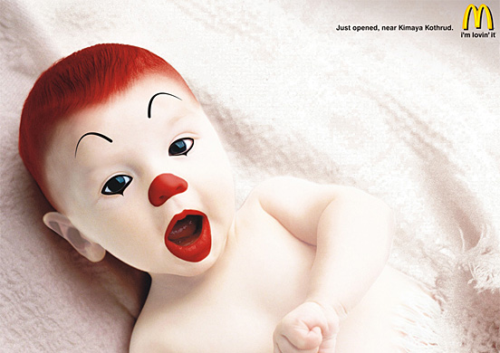
2. McDonald’s baby

Slide 4
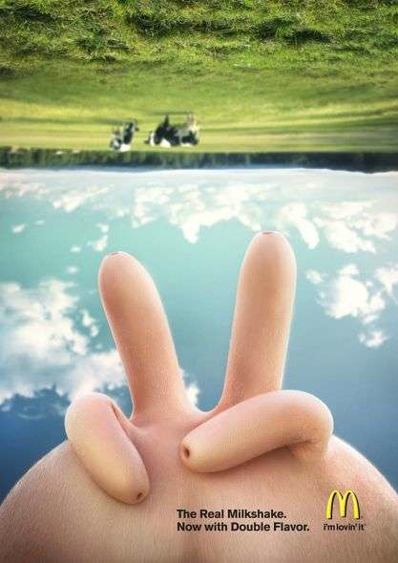
3. The real milkshake

Slide 5
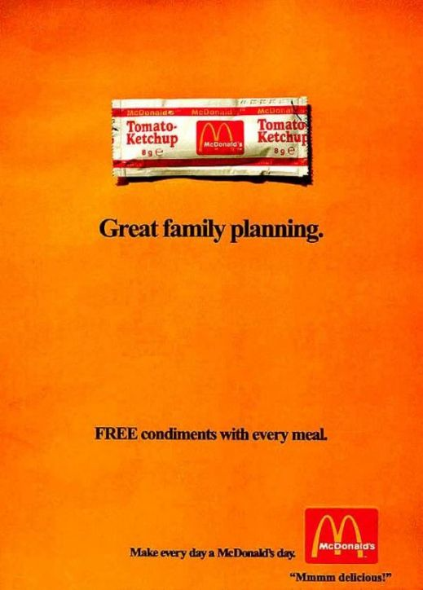
4. Free condiments

Slide 6
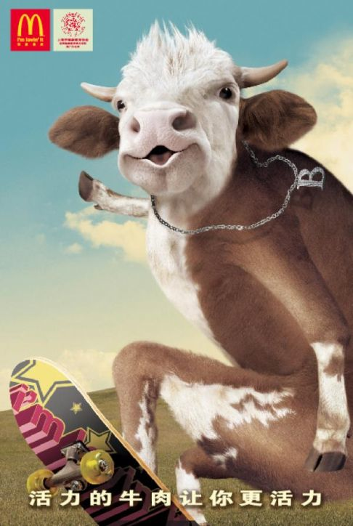
5. Skateboarding cow

Slide 7
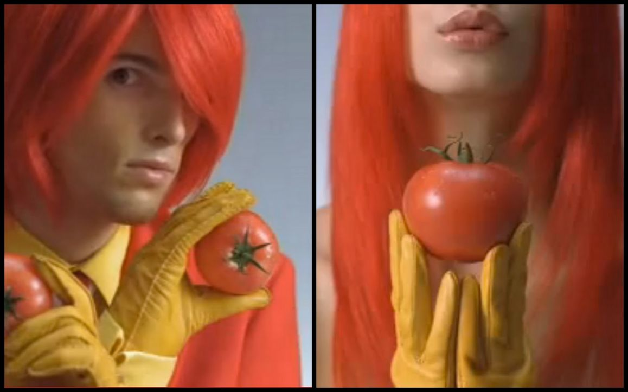
6. Holding tomatoes

Slide 8
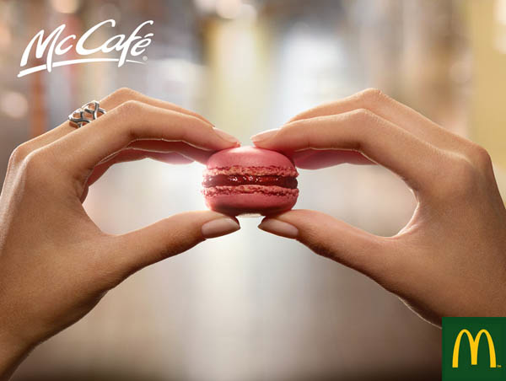
7. McCafe

Slide 9
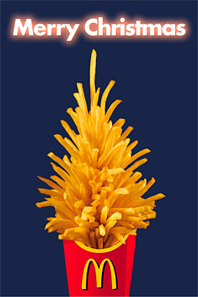
8. Merry Christmas

Slide 10
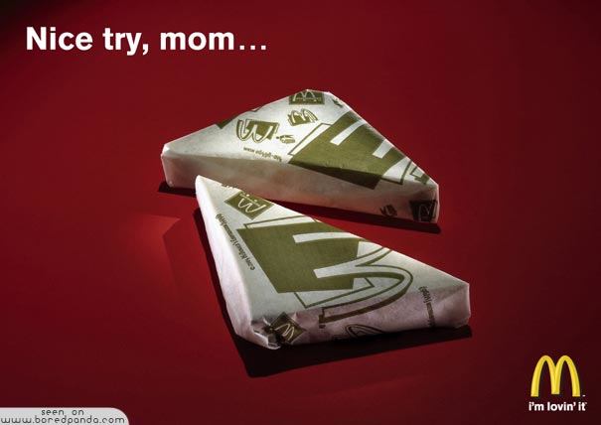
9. Nice try, mom…

Slide 11

10. French fries

